Slide 1
Variable Transformation
Regression Analysis and Non-Linear Models: Sociology 6100

Slide 2
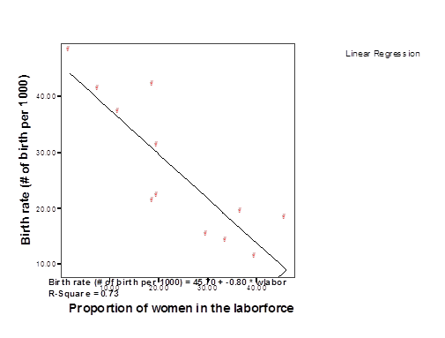
Review of Outliers and Heteroscedasticity
Errors are not correlated with each other
Errors (residuals) are normally distributed
Check scatter diagram of DV and major IV

Slide 3
Review of Outliers and Heteroscedasticity (cont.)
Case wise residuals
Case Number | Std. Residual | Respondent's Income | Predicted Value | Residual
4 | 3.195 | 22 | 8.49 | 13.507
91 | 3.352 | 22 | 7.83 | 14.174
108 | 3.805 | 22 | 5.91 | 16.089
136 | 3.448 | 22 | 7.42 | 14.578
148 | 3.111 | 22 | 8.84 | 13.156
226 | 3.253 | 22 | 8.25 | 13.753
247 | 3.244 | 22 | 8.28 | 13.718
689 | 3.549 | 20 | 5.00 | 15.004
853 | -3.466 | 4 | 18.65 | -14.655
1063 | -3.033 | 1 | 13.82 | -12.825
Casewise Diagnostics(a)
a Dependent Variable: Respondent's Income

Slide 4
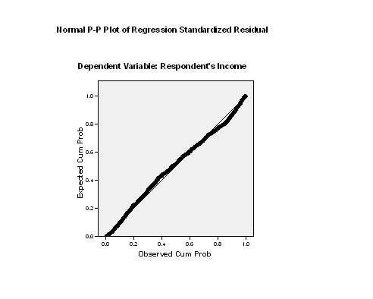
Review of Outliers and Heteroscedasticity (cont.)
Normal Probability Plot (PP)

Slide 5
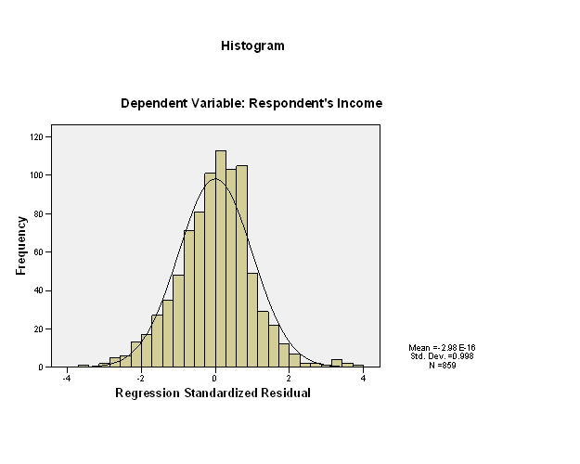
Review of Outliers and Heteroscedasticity (cont.)
Histogram of Standardized residuals (ZRESD)

Slide 6
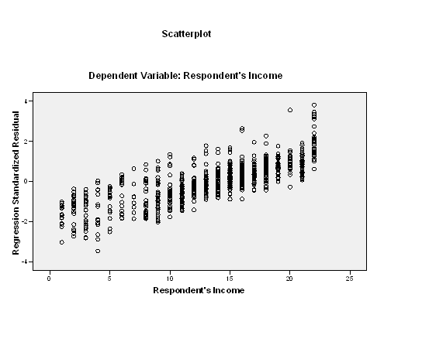
Review of Outliers and Heteroscedasticity (cont.)
Scatter diagram of Z-Residuals

Slide 7
Review of Outliers and Heteroscedasticity (cont.)
Solutions
Conduct influence analysis to identify cases which have impact on the estimate greater than other cases
If outliers are < 5-10% of the sample, delete them (how large is the sample?) by case wise diagnostic
Delete IV’s which have heteroscedasticity
Transformation of IV which does not have linear relationship with DV

Slide 8
Transformation Technique
When to use transformation
To pull in outliers when there is heteroscedasticity
To build a theoretical model
Eg. Population explosion
Y: Population size at year X
α: Population size at year 0
β: Population growth rate/year
X: Years
Y = αβ^{x}
When β=2% and X=35, Y = α(1.02)³⁵= 2α
Population doubled in 35 years.
LogY = α + βX

Slide 9
Transformation Technique (cont.)
Eg. Organizational growth
Y: Size of organization
X: Years
Y= α + β logX
As organization becomes older, size increases (# of employees). However, there is a diminishing effect of X on Y.

Slide 10
Types of Transformation
a) Logarithmic transformation (diminishing effect of X on Y)
Y= α + β logX
When β >0, as X value increases Y value increases, but the effect of X diminishes. (eg. Hours studied and test scores)
When β <0, as X value increases Y value decreases, but the effect of X diminishes. (eg. Length of sleep and # of errors)

Slide 11
Types of Transformation (cont.)
b) Quadratic/polynomial term
Y= α + βX²
When β>0, the line is upward curve linear.
When β<0, the line is downward curve linear.

Slide 12
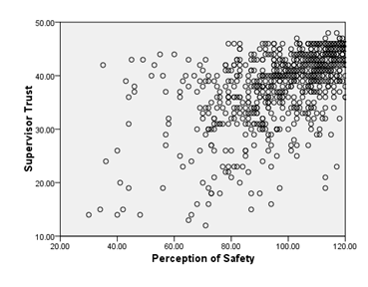
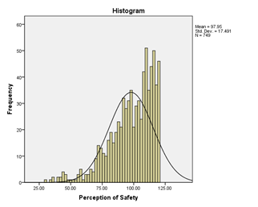
Types of Transformation (cont).
Examples

Slide 14
Questions?

